Slide 1
Structured coding using dataframes and datasets

Slide 2

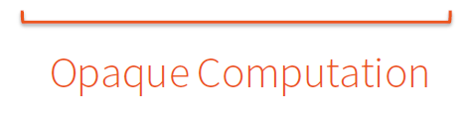
What is wrong with just using RDDs?
When you write code like this
The lambda function (computation) is opaque to spark, so it can not do any optimization.
The filter function is designed to take any predicate lambda function.

Slide 3
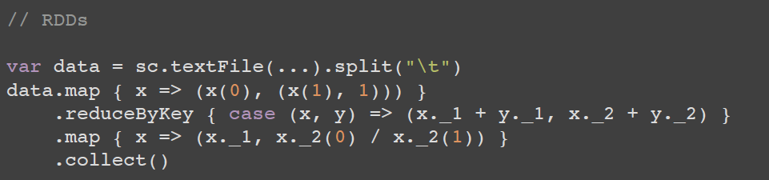
Structured versus Unstructured Code
Unstructured code (computes an average per group)
Hard to read
What information is in x(0), x(1)?
Spark can not optimize the code since lambda functions used are opaque to it
Structured code (also computes average per group)
Easier to read, the columns are given proper names instead of x(0), x(1)
Spark can optimize this code since it uses Sparks SQL functions.
Slide credit: http://scala-phase.org/talks/rdds-dataframes-datasets-2016-06-16/#/9

Slide 4
DataFrames
DataFrames lets you write nice structured code like this:
However, it does not provide type safety
For example if the column “name” does not exist you will not know this until there is an error at run time.
So your code may have already done a lot of work and then it suddenly crashes since it finds that the column you are trying to use does not exist
Slide credit: http://scala-phase.org/talks/rdds-dataframes-datasets-2016-06-16/#/9

Slide 5
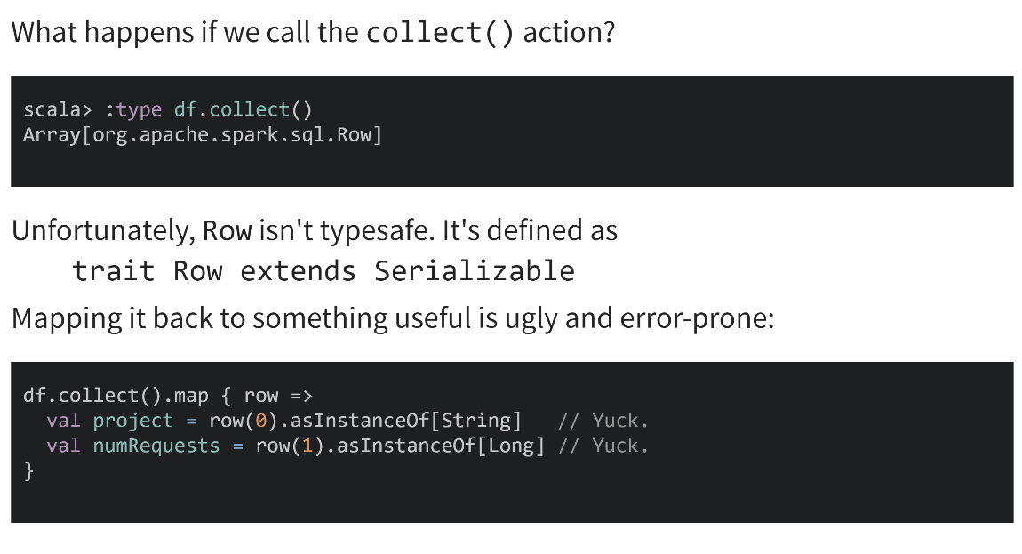
Data Frames do no have type safety
Slide credit: http://scala-phase.org/talks/rdds-dataframes-datasets-2016-06-16/#/9

Slide 6
Datasets
Conceptually similar to RDDs. (You can use lambdas and types again.)
Use Tungsten's fast in-memory encoding (as opposed to JVM objects or serialized objects on the heap)
Expose expressions and fields to the DataFrame query planner, where the optimizer can use them to make decisions. (This can't happen with RDDs.)
Slide credit: http://scala-phase.org/talks/rdds-dataframes-datasets-2016-06-16/#/9

Slide 7
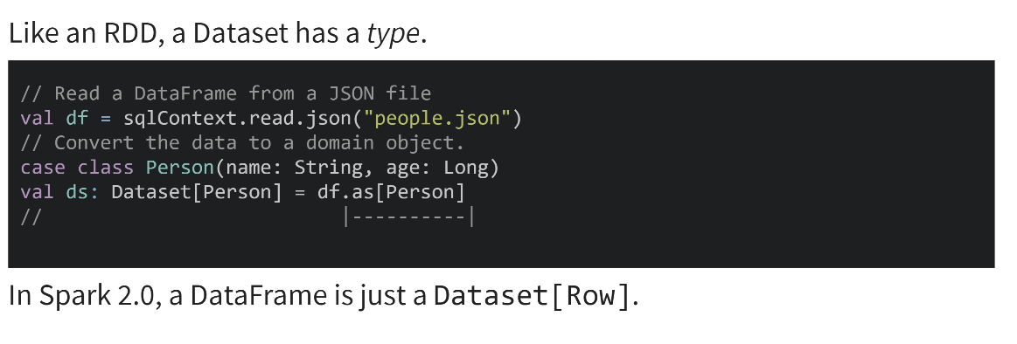
Datasets
In the above code the DataFrame is converted to a Dataset by specifying the type using the as function. In this case the type is the case class Person.

Slide 8
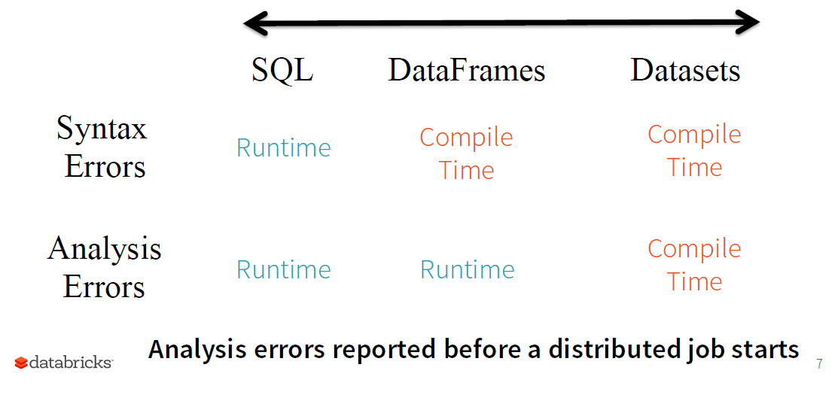
Why use structured code? (Can find errors earlier)
e.g. spelt SELECT wrong
e.g. column does not exist

Slide 9
DataFrame = Dataset[Row]
DataFrames are just Dataset of Rows in Scala and Java API
Spark 2.0 unifies DataFrame and Dataset APIs
DataFrames are just Dataset of Rows in Scala and Java API.
Can not check analysis errors at compile time
These operations are also referred as “untyped transformations” in contrast to “typed transformations”
Ask Spark SQL to enforce types on generic rows using df.as[MyClass]
Can check analysis errors at compile time
Typed transformations

Slide 10
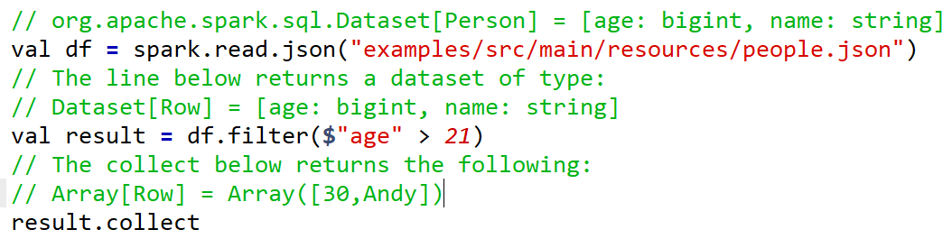
Typed versus Untyped transformations
Here are example untyped transformations using dataframes
Notice in the above code the output from the collect action is an array of Rows. The columns in each row are not named and hence you would need get them via row(0) for age and row(1) for name

Slide 11
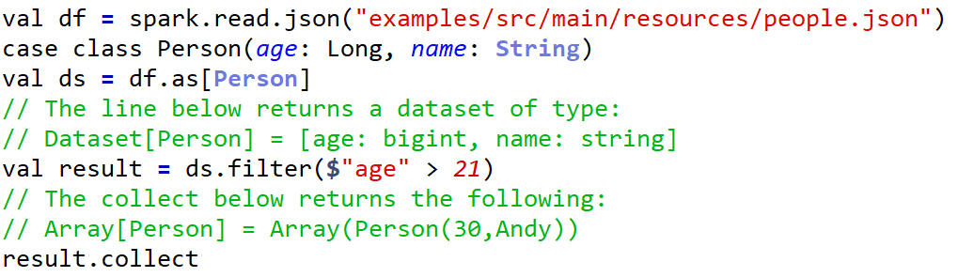
Typed versus Untyped transformations
Here is the same example using typed transformations on a dataset which has the Type Person specified
Notice in this case the collected array has elements with type Person. This is much nicer since you can use person.age and person.name to extract the age and name columns.

Slide 12
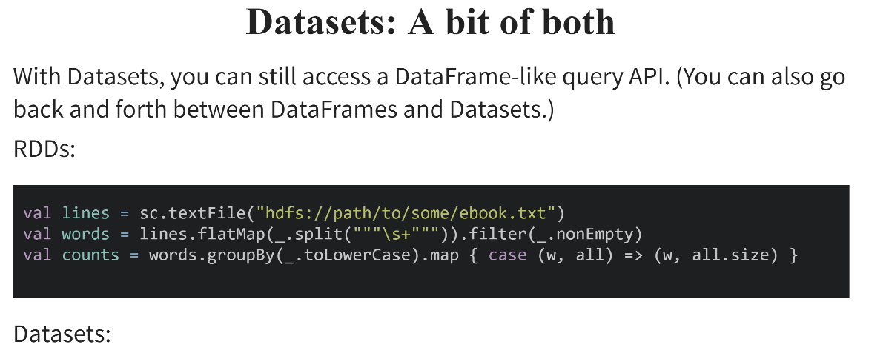
Slide credit: http://scala-phase.org/talks/rdds-dataframes-datasets-2016-06-16/#/9

Slide 13
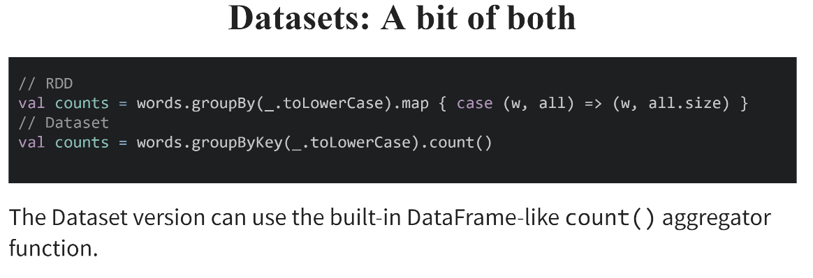
Slide credit: http://scala-phase.org/talks/rdds-dataframes-datasets-2016-06-16/#/9

Slide 14
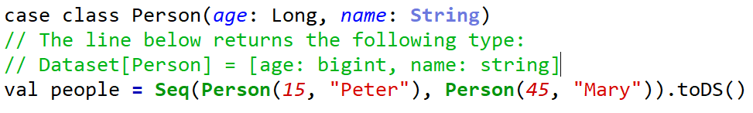
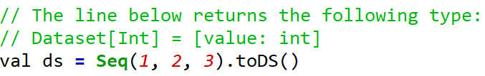
Another way to create a data set
The toDS() can be used to create a data set.

